Slide 1
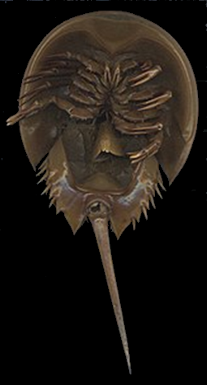
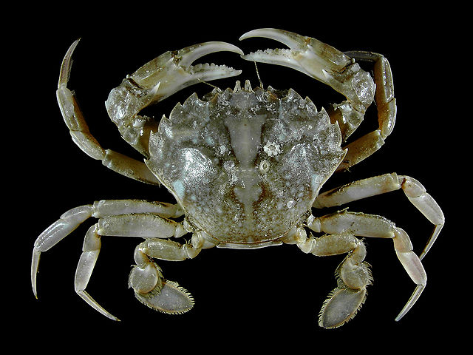
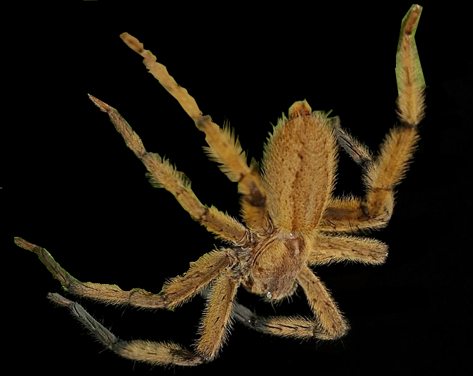
Kingdom: Animalia
Phylum: Arthropoda
Subphylum: Crustacea
Subphylum: Chelicerata
Class: Merosomata
Class: Arachnida
Charles J. Sharp
Hans Hillewaert

Slide 2
Kingdom: Animalia
Phylum: Arthropoda
Subphylum: Crustacea
Subphylum: Chelicerata
Class: Arachnida
Order: Xyphosura
Order: Ricinulei
Charles J. Sharp
Hans Hillewaert

